Slide 1
NHS Data Analysis Results
July 2024

Slide 2
Presented by
Beata Faitli
LSE Career Accelerator student

Slide 3
Content
Background and context
Key insights
Recommendations

Slide 4
Background and context
- The analysis covered a 30-month reporting period from 01/2020 to 06/2022
- The analysis included 3 datasets provided by the NHS for appointment data and twitter data
- The data analysis was enriched with further twitter data, patient population data, staffing data, COVID-19 and weather data for additional insights

Slide 5
Context of the time-period
March 2020
Dec 2020
Nov 2021
March 2022
July 2022
First Lockdown due to COVID-19
Vaccination programs begin
Omicron variant surge
COVID-19 restrictions phased out
NHS catching up with postponed elective and routine care
NHS structure changed to the Integrated Care Board replacing the CCGs
Hannah Morales
President

Slide 6
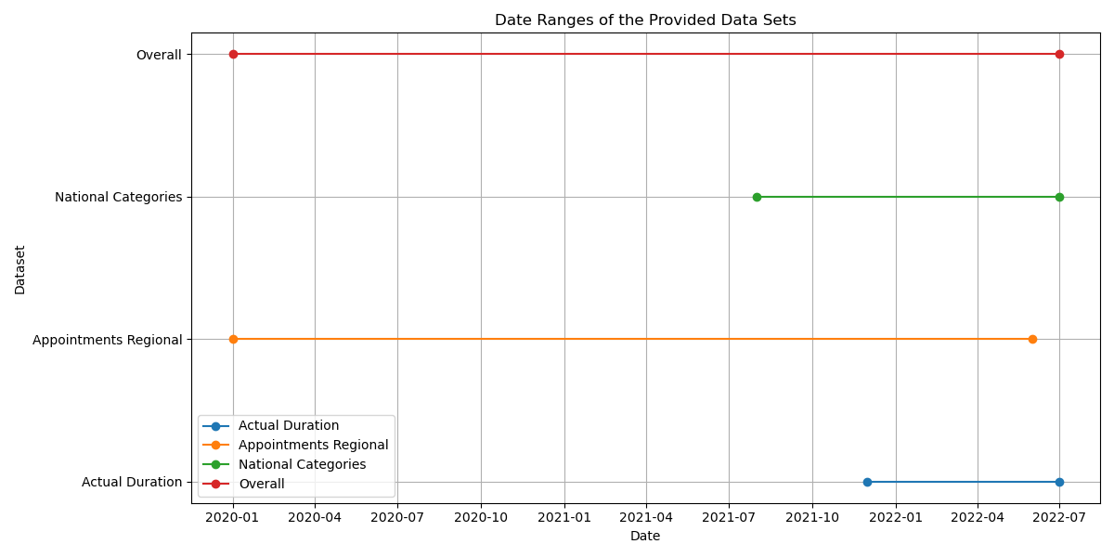
Limitations of the available data
The provided files covered different timeframes and metrics
and varied between daily and monthly views
- Although reliable sources were used for the additional data
caution is advised in interpreting results from these data points.
- Data cleaning and accuracy was ensured on all files used in the analysis.
Daily appointment view
Monthly appointment view
Hannah Morales
President
Daily appointment view

Slide 7
Has there been adequate staff and capacity in the networks?

Slide 8
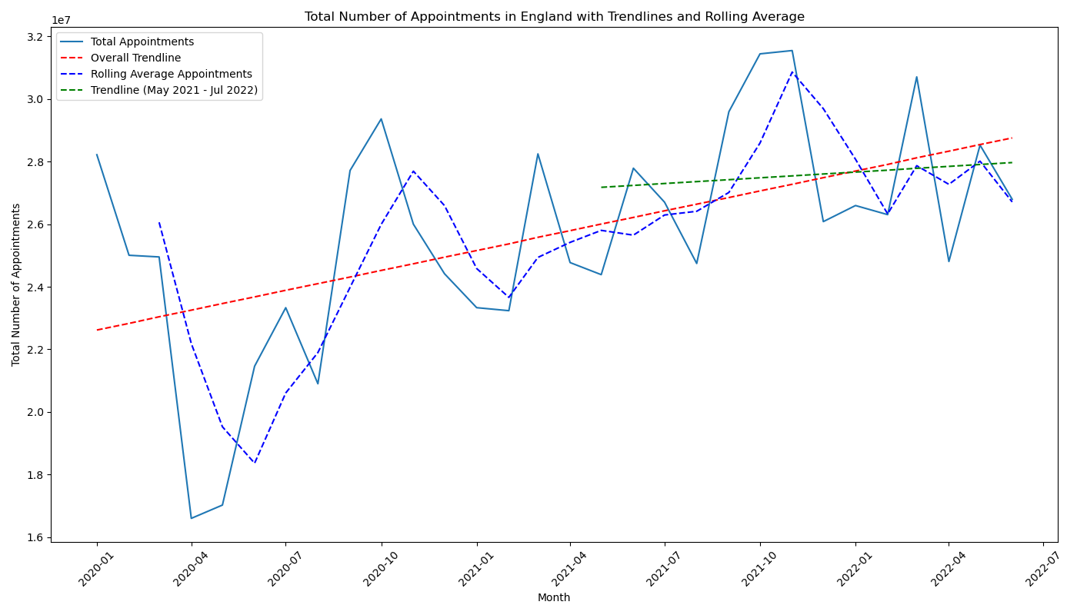
Total appointment trends
10 Million
Autumn
Spring
Autumn
Spring
COVID-19 lockdown

Slide 9
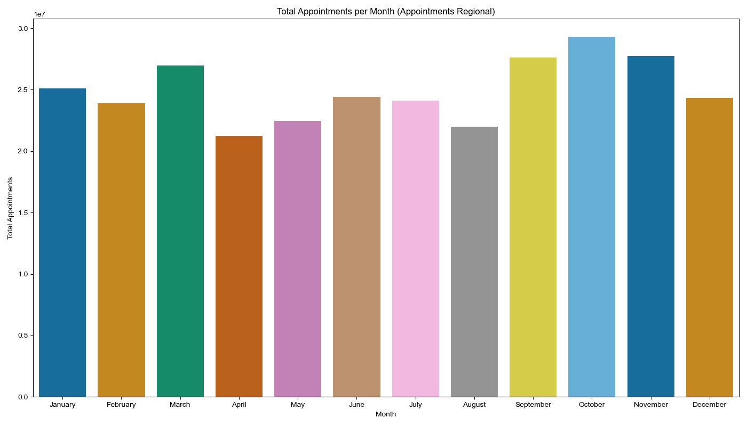
Total appointments by month
10 Million

Slide 10
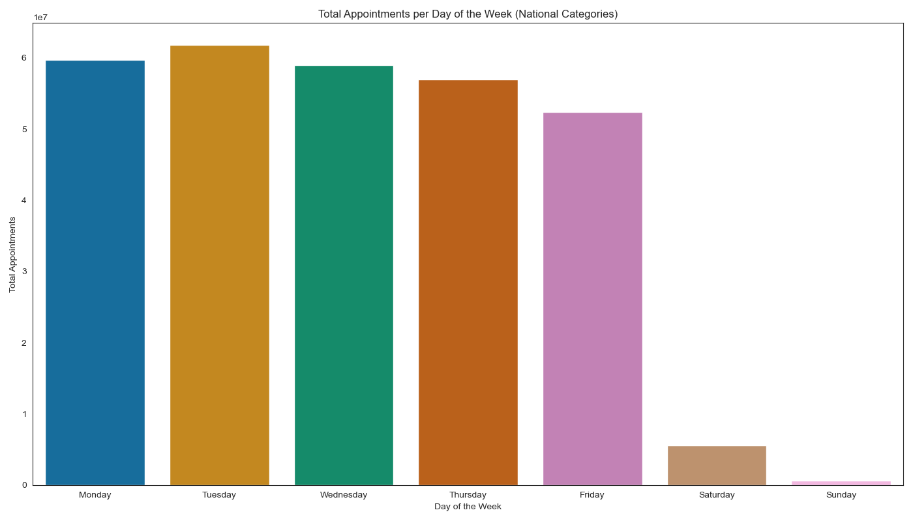
Total appointments by day (between 08/2021-06/2022)
10 Million

Slide 11
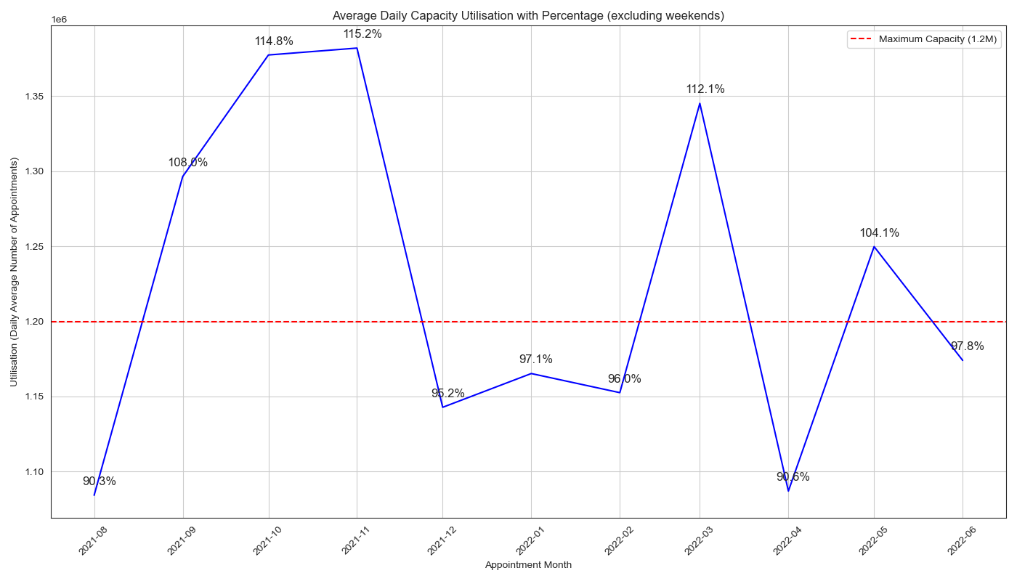
Average daily capacity excluding weekends Note: Capacity ranged between 65.5%-84% when weekends are included
Million
Maximum capacity
Hannah Morales
President

Slide 12
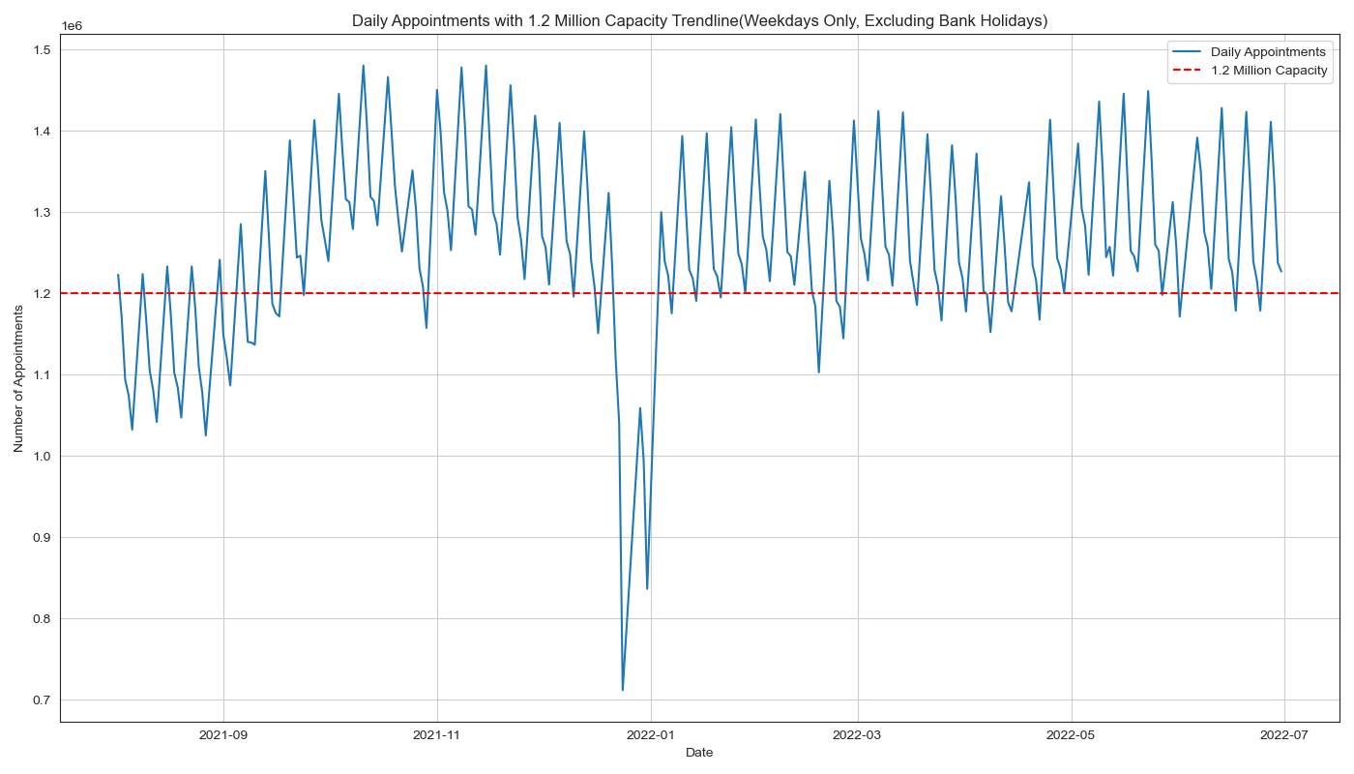
Daily capacity excluding weekends and bank holidays
Million
Maximum capacity
President

Slide 13
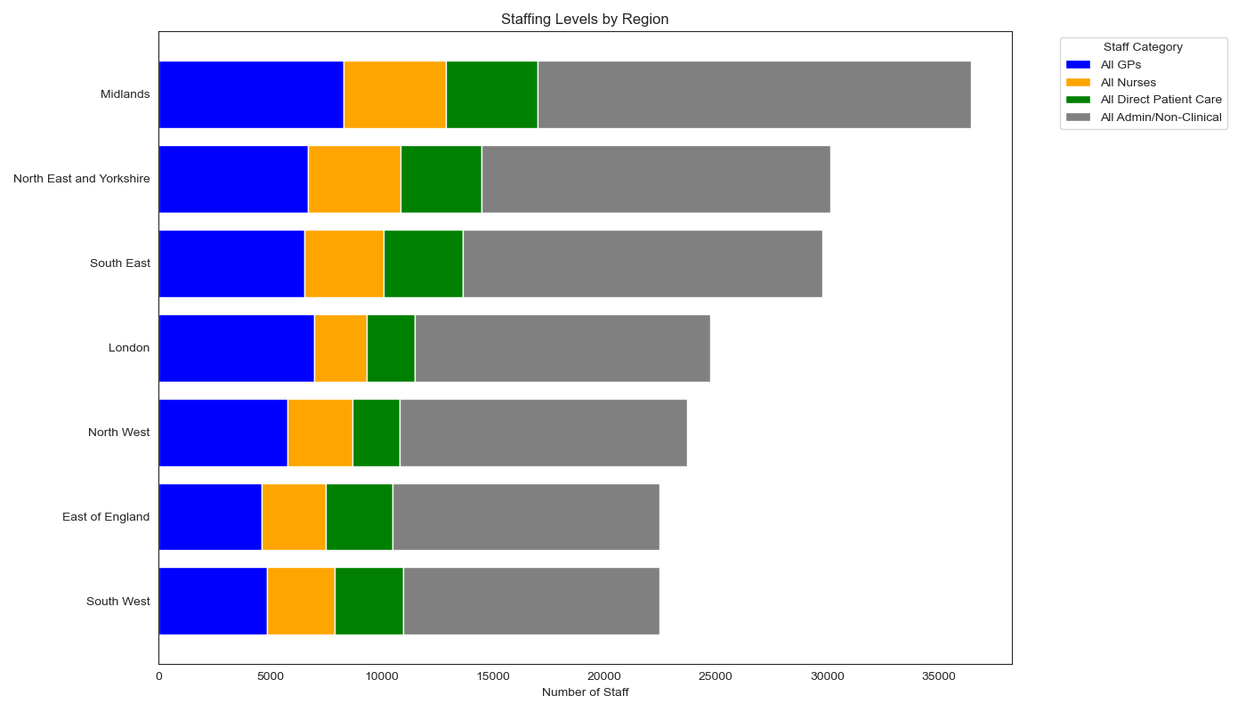
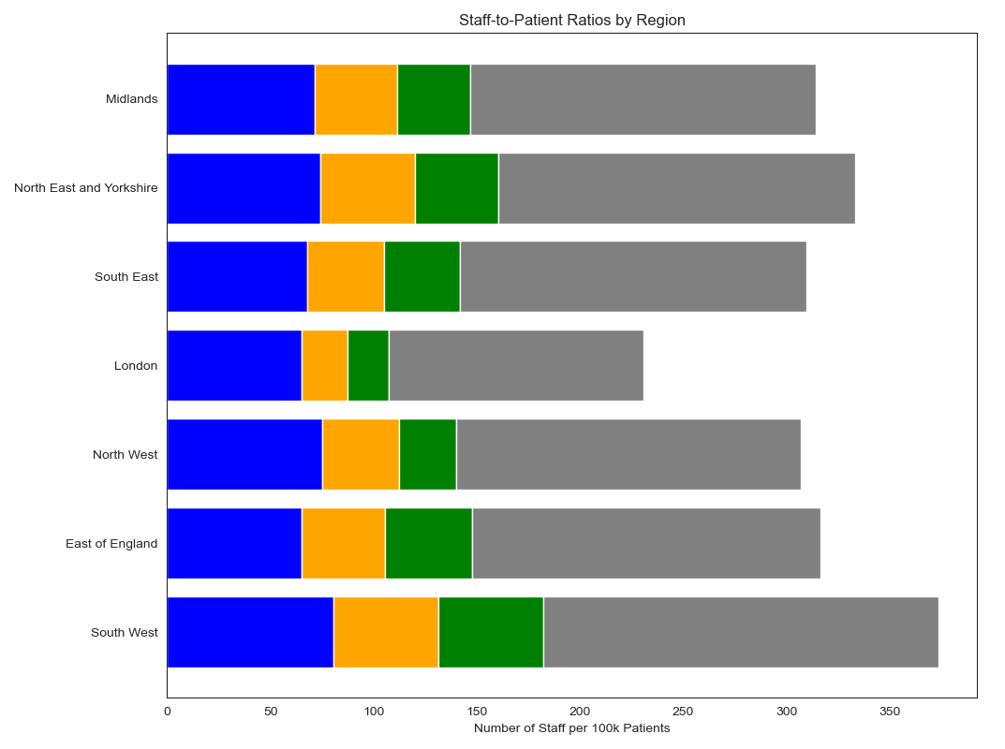
Regional Staffing levels Note: Staffing data covers 07/2022 values
President

Slide 14
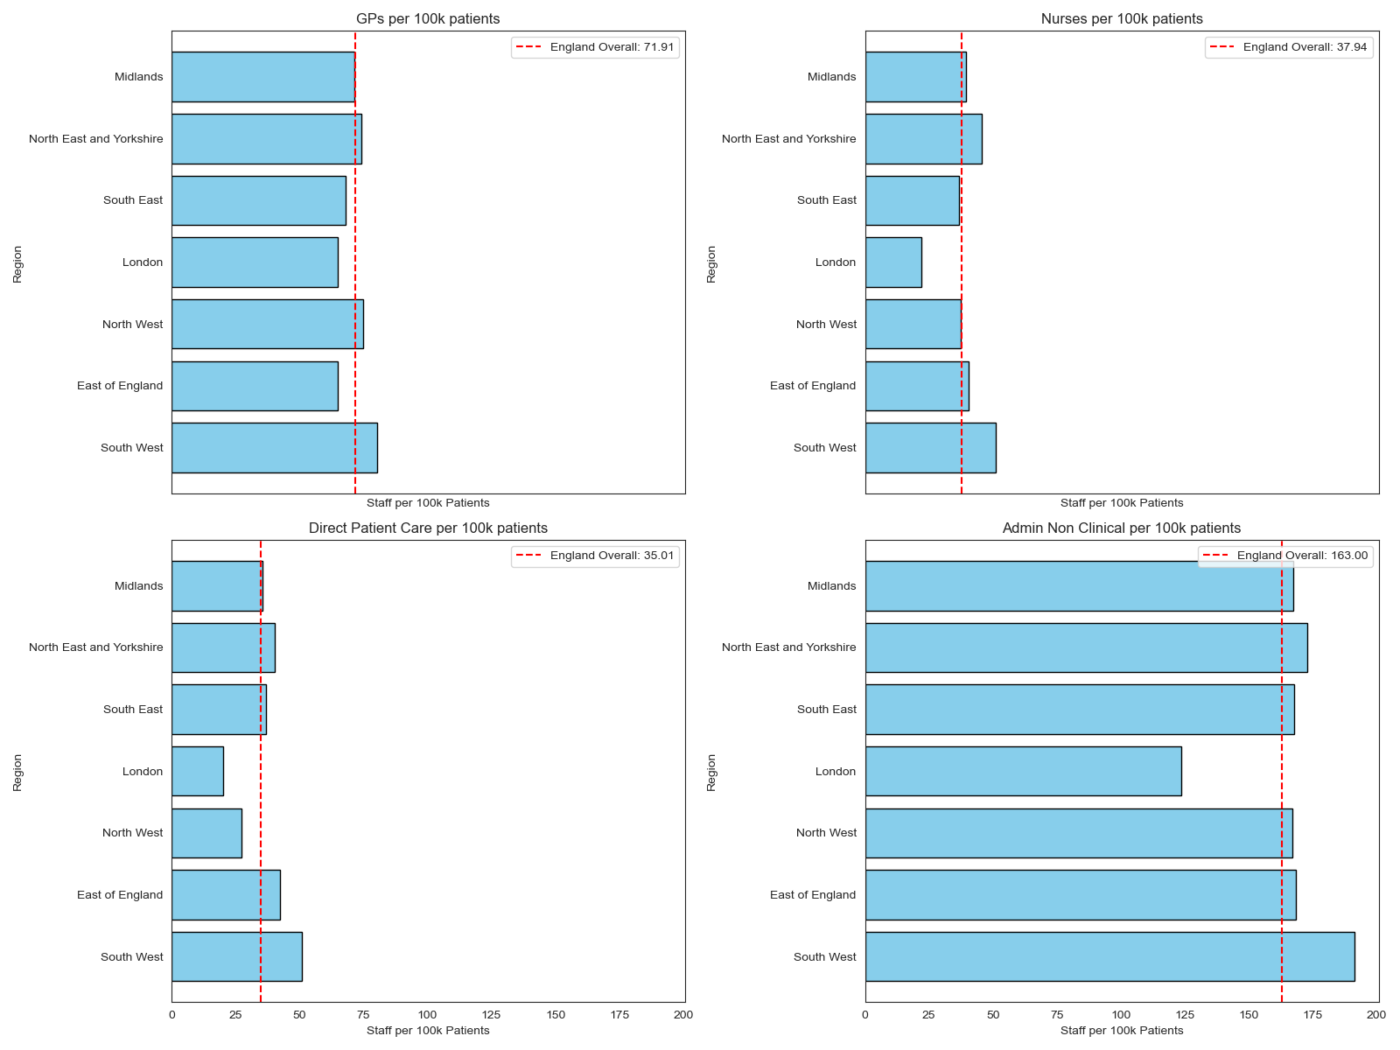
Million
President

Slide 15
Total appointments, average appointments,
total appointments per GP surgery and per capita appointments per Region
President
Note: Patient data used was from 08/2022. GP patient numbers grew by 2.5% during the 30 month reporting period.

Slide 16
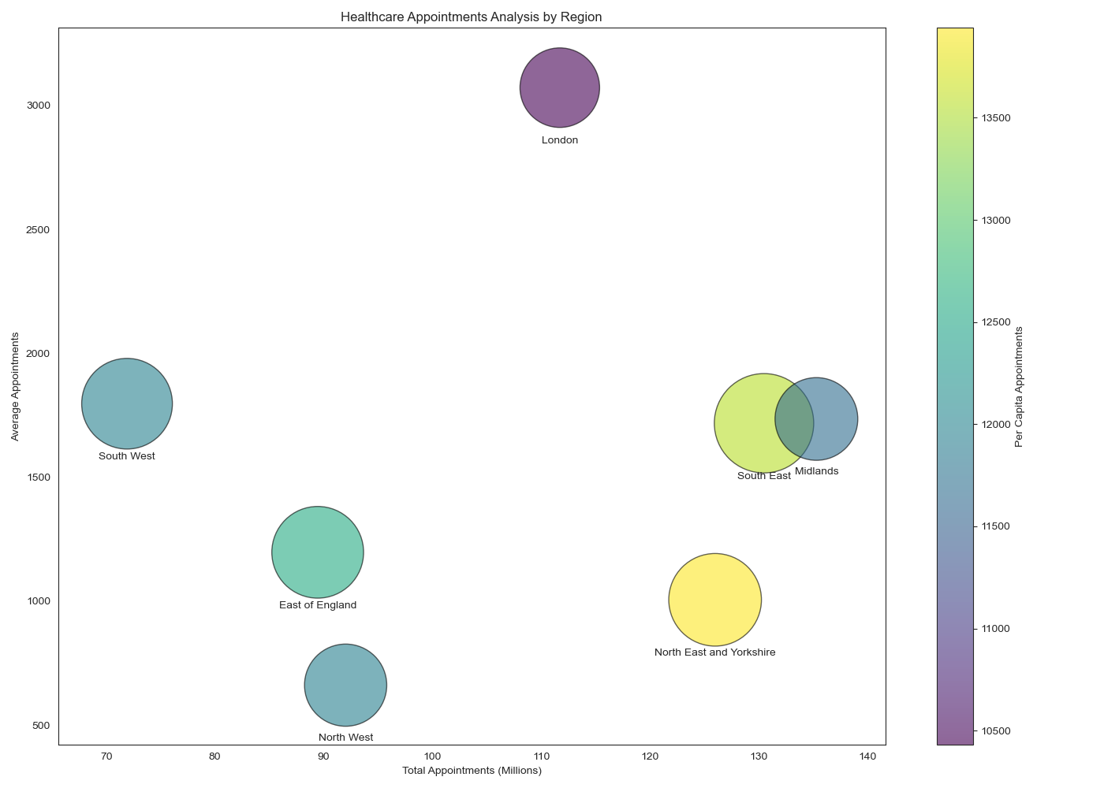
President

Slide 17
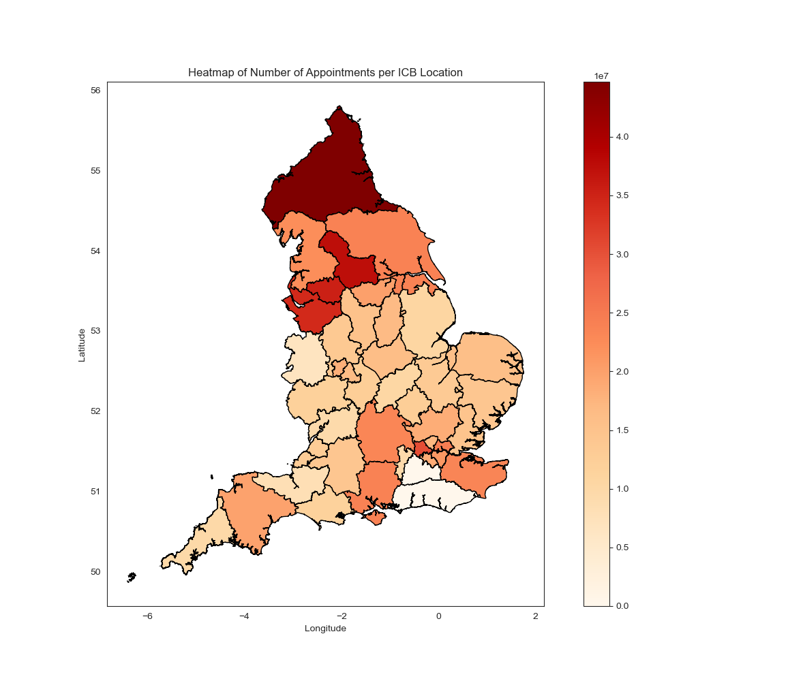
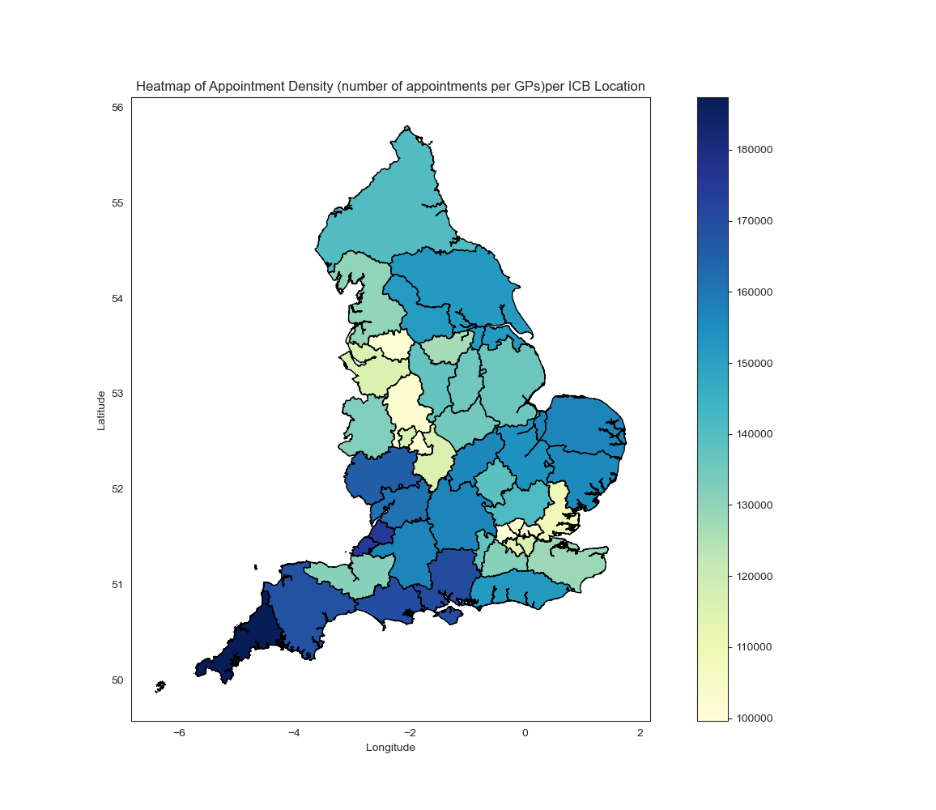
Total appointments and appointments per GP in the ICBs
Number of Appointments per ICB Location:¶
High Number: Northern regions (e.g., North East and North Cumbria, Greater Manchester) have a high number of appointments.
Low Number: Southern and Central regions have a relatively lower number of appointments.
Appointment Density per ICB Location:
High Density: South West regions (e.g., Cornwall) show higher appointment densities.
Low Density: Central and Northern regions show lower appointment densities.

Slide 18
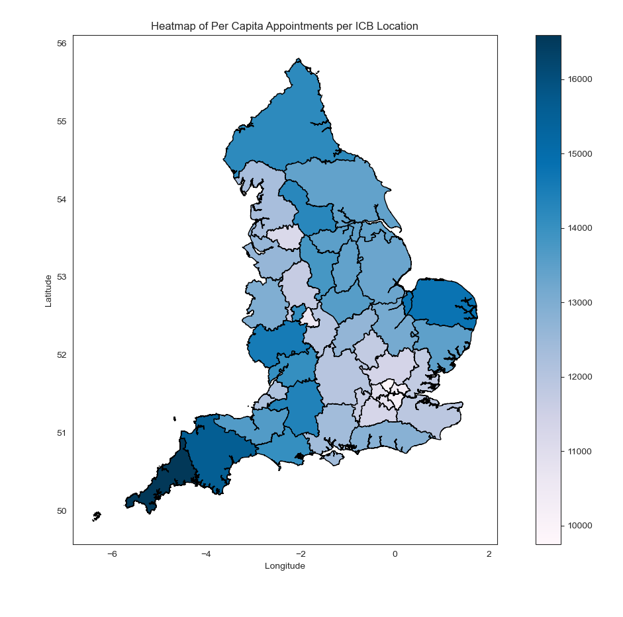
Per capita appointments in the ICBs
Per Capita Appointments per ICB Location:
High Per Capita: Regions in the South West and
some East of England areas have higher per capita appointments.
Low Per Capita: London regions show lower per capita appointments.

Slide 19
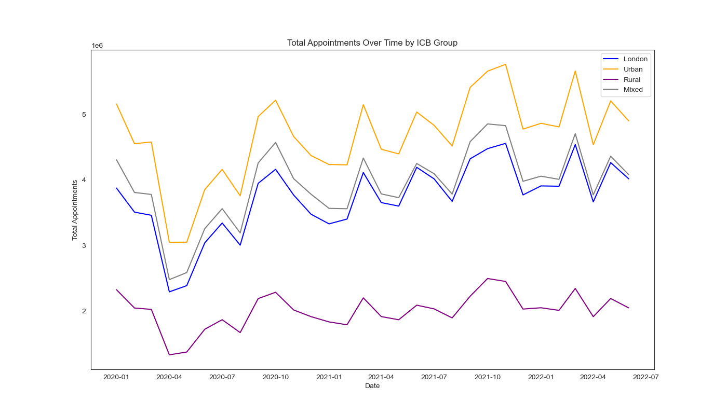
Appointment trends by ICB type
Million

Slide 20
What was the actual utilisation of resources?

Slide 21
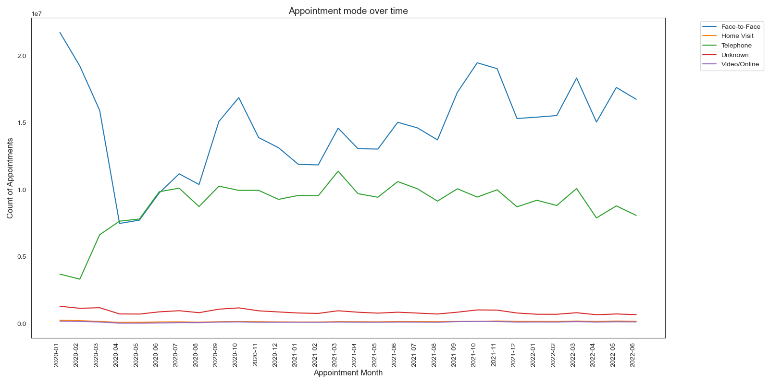
Appointment types over time
10 Million
COVID19-Lockdown
President

Slide 22
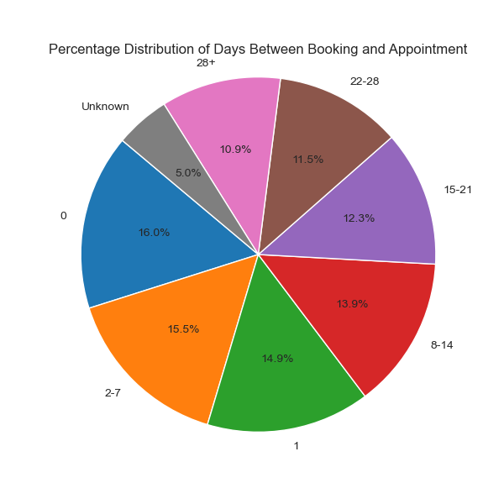
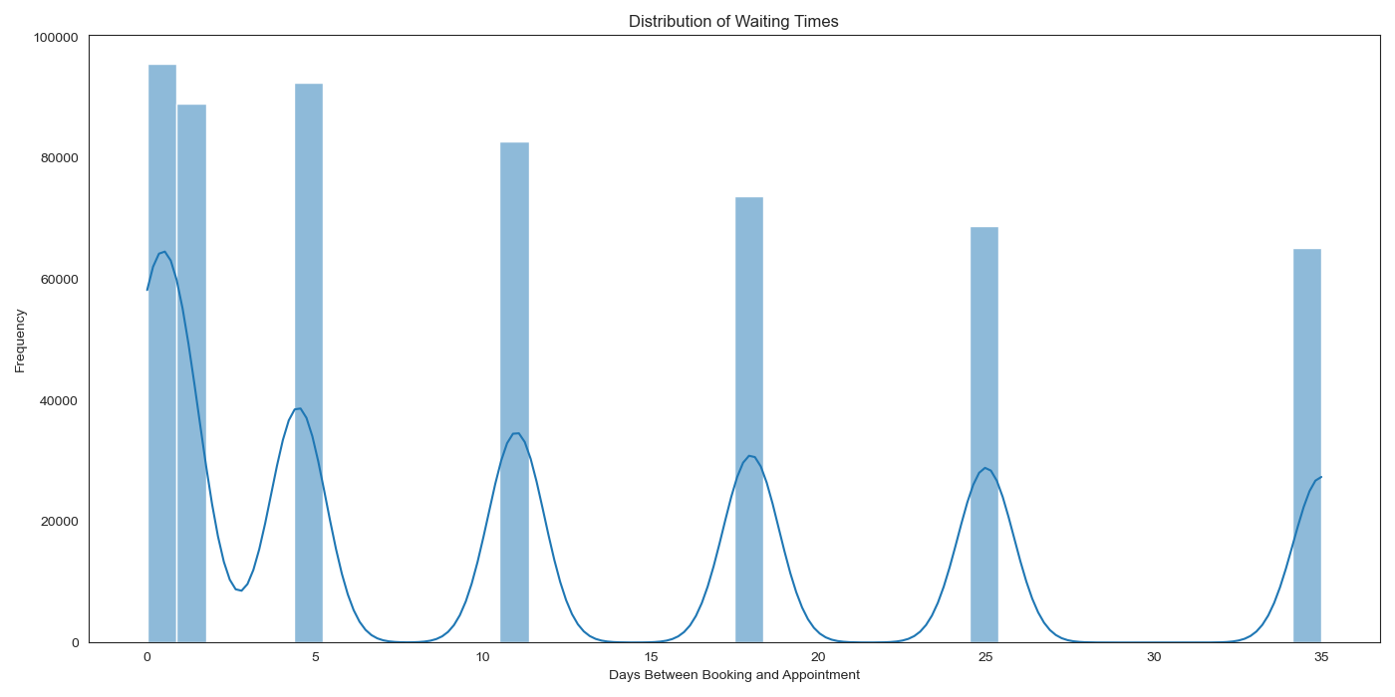
Waiting times
President

Slide 23
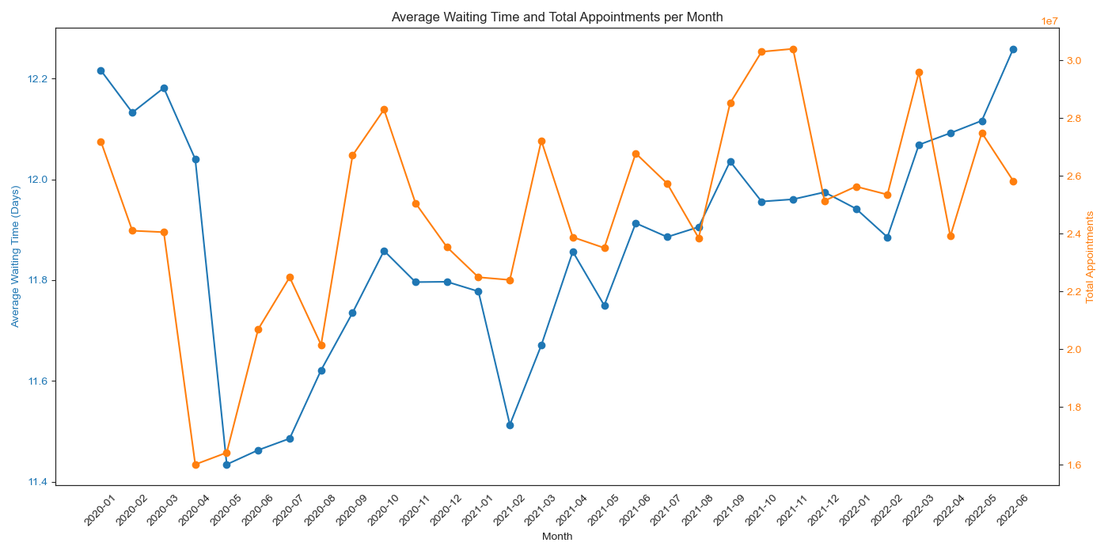
Average waiting time trends
10 Million
President

Slide 24
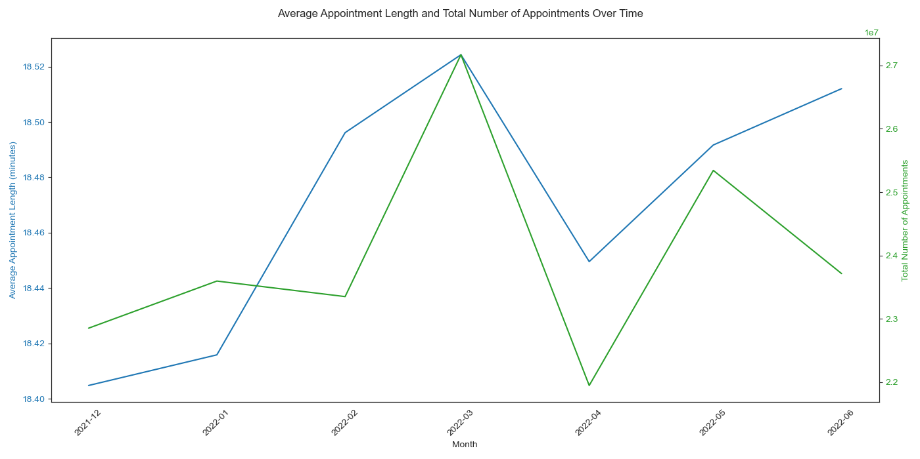
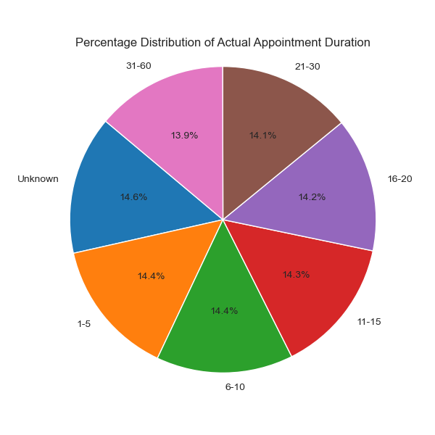
Appointment length (between 01/12/21- 30/06/22)
President

Slide 25
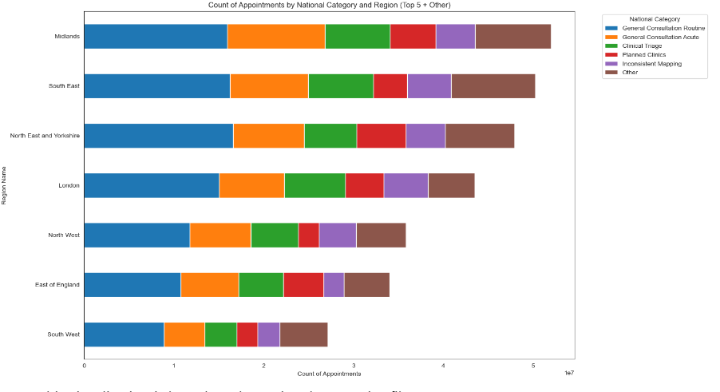
National Categories
President
10 Million

Slide 26
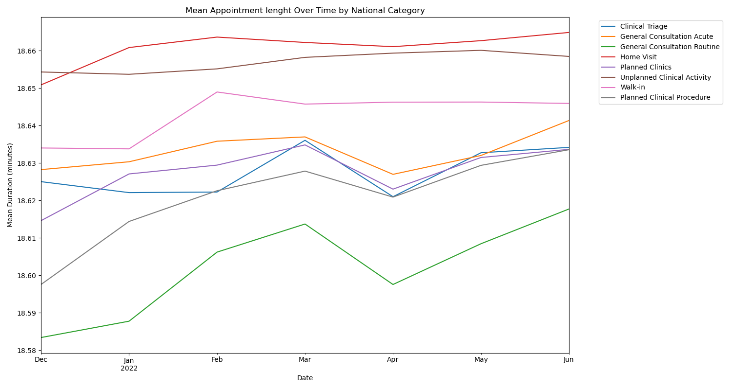
Appointment length by categories (between 01/12/21- 30/06/22)
Percentages for 31-60 minute long appointments:
Inconsistent Mapping: 11.46%
General Consultation Routine: 11.18% General Consultation Acute: 10.93% Planned Clinics: 9.25%
Clinical Triage: 9.18%
President

Slide 27
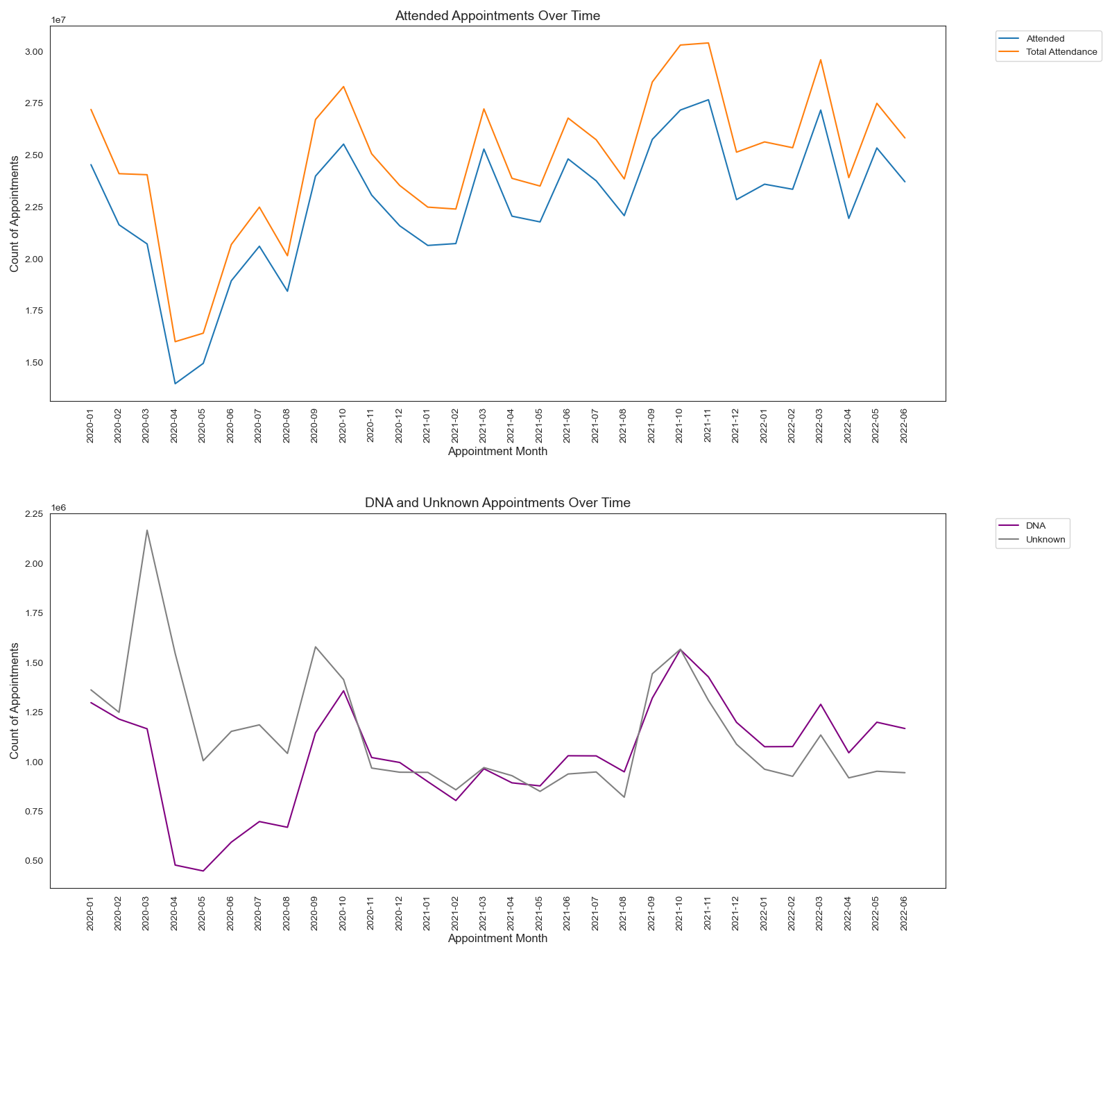
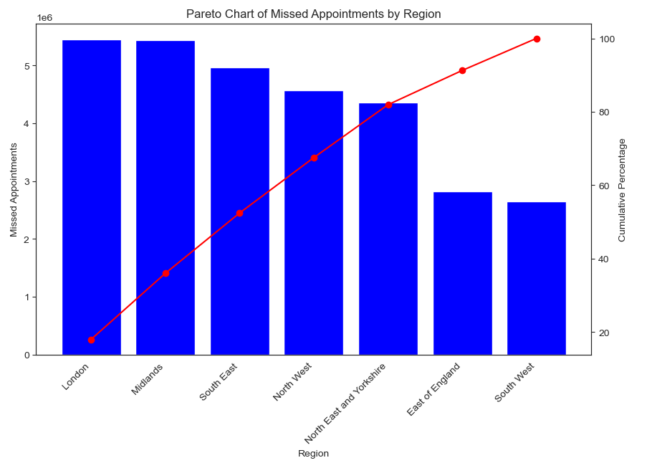
Missed appointment (DNA) trends
10 Million
Missed appointments costs the NHS £216million pounds per year
about £ 30 per appointment (2019)
Considering that around 5% of all appointments are missed
on average around 1 Million appointments per month
(at least £360 M during the reporting period)
Million
Million
President

Slide 28
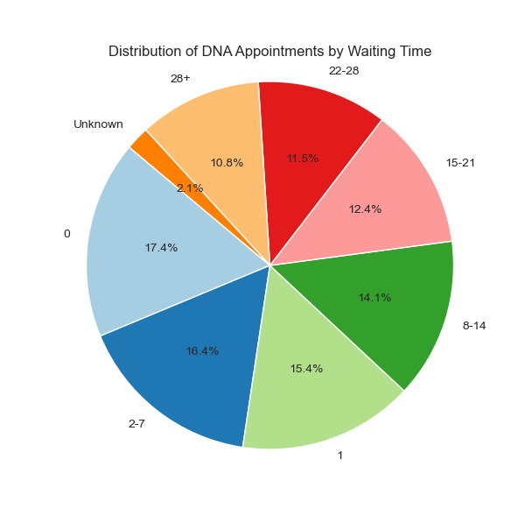
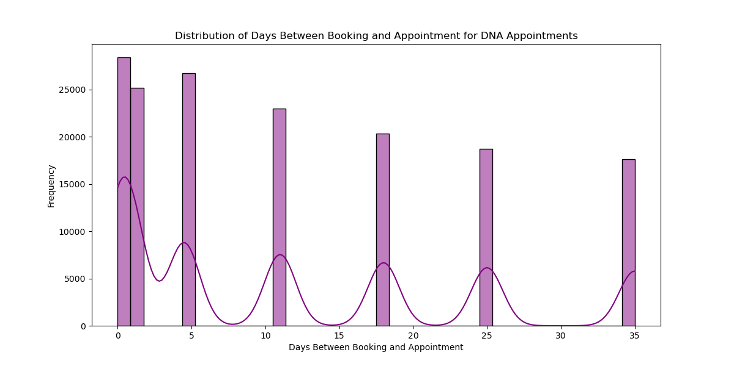
Missed Appointments (DNA) and waiting times
President

Slide 29
T
X (Twitter) Analysis
Top trending hashtags:
# healthcare
# health
# job
Top locations:
Top mentioned words:
Chicago
USA
Canada
Few UK locations
Health
Healthcare
Medical
Patient
# healthcare
# health
# job
Sentiment:
Only 3 NHS Mentions
Neutral to positive sentiment

Slide 30
Recommendations
Appointment length management
Seasonal capacity management – Increase the overall maximum capacity to 1.4-1.5 M
Improved Data Mapping and Reporting
Regional Staffing Adjustments
Resilience Building for future outbreaks
Telehealth and Online Appointments
Strain on Services – review maximum capacity
Waiting time reduction

Slide 31
Further analysis
Further analysis to reasons for service Overutilization
Impact of Seasonal and External Factors, such as weather
Integration of Patient and Staffing Metrics
Longitudinal and predictive Analysis of recent data
Local Performance Analysis
Reasons for missed appointments
Predictive analysis

Slide 32
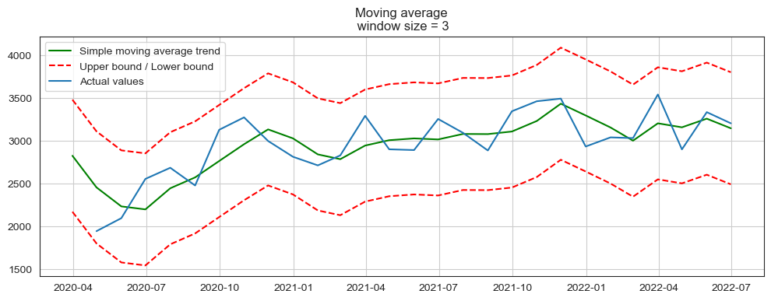
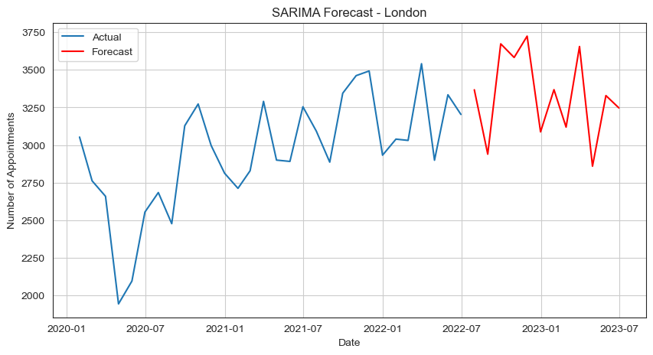
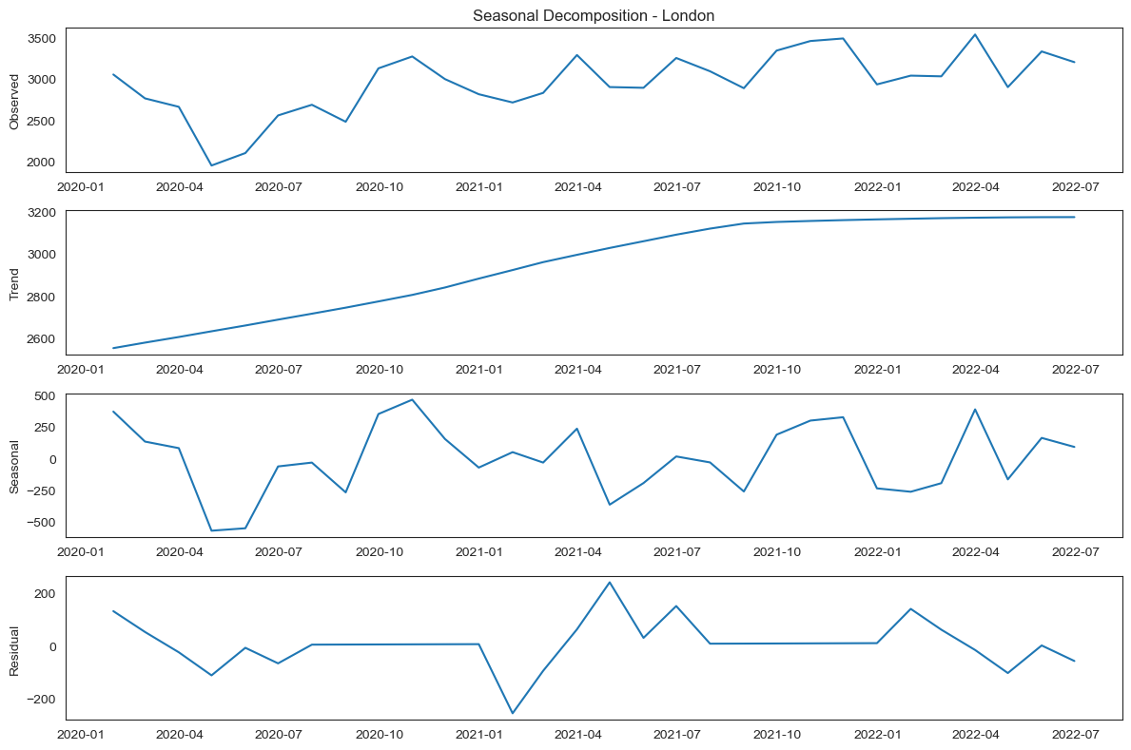
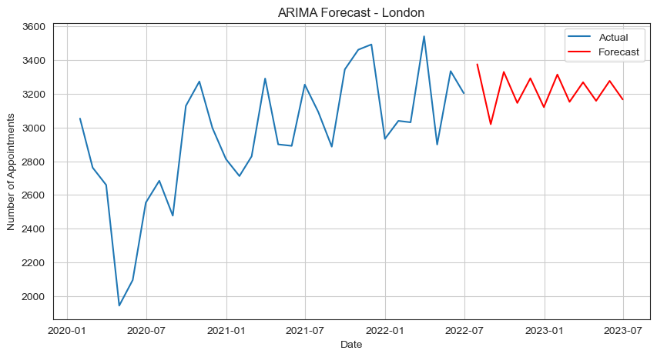
Looking at the future - Predictive modelling (London Example)
President

Slide 33
Thank You

